Slide 1
Web Engineering
An introduction

Slide 2
Motivation
The World Wide Web is omnipresent!
Why?
global and permanent availability
comfortable and uniform access
anyone can produce and publish contents

Slide 3
Examples
Search Engine
Information
Announcement
Computation
Mixed

Slide 4
Basic paradigms
Hypertext + Internet
Hypertext: textual documents together with the ability to interconnect documents by links between them as part of the document contents
HTML: HyperText Markup Language
HTTP: HyperText Transfer Protocol

Slide 5
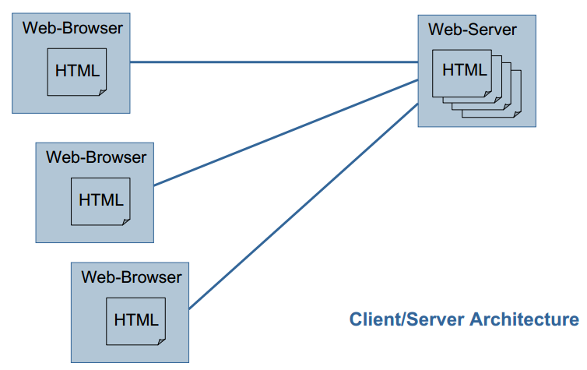
Conceptual Architecture

Slide 6
History of the Web
1969: ARPA (Advanced Research Projects Agency)
First small network: Stanford Research Institute, UCLA, UC Santa, Barbara, Univ. of Utah
TCP (Transmission Control Protocol)
IP (Internet Protocol)
1972: Telnet protocol
1973: SMTP (Simple Mail Transfer Protocol)
1973: FTP (File Transfer Protocol)
1989: T. Berners-Lee et al.: Word Wide Web (WWW)
1994: W3C (World Wide Web Consortium)
1996: HTTP (HyperText Transfer Protocol)

Slide 7
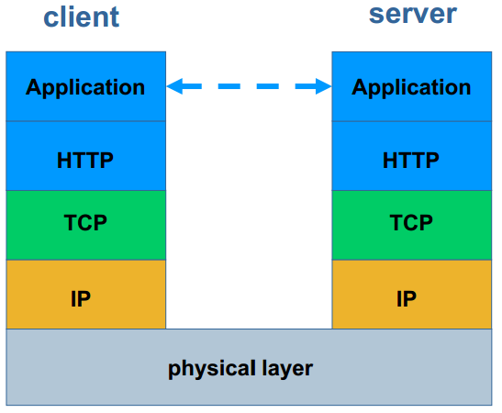
Protocol Stack

Slide 8
World Wide Web Consortium (W3C)
international consortium where member organizations, a full-time staff, and the public work together to develop Web standards
http://www.w3.org
W3C's mission:
to lead the World Wide Web to its full potential by developing protocols and guidelines that ensure long-term growth for the Web.

Slide 9
Web Application
A Web Application is a software system based on technologies and standards of the World Wide Web Consortium (W3C) that provides Web specific resources such as content and services through a user interface, the Web browser.
[Kappel et al. 2004]

Slide 10
Categories of Web Applications

Slide 11
Categories of Web Applications (1/5)

Slide 12
Categories of Web Applications: document-centered
Informational
read-only content is provided with simple navigation and links
Download
a user downloads information from the appropriate server (ftp-server)
Customizable
the user customizes content to specific needs
examples:
static HTML-pages, „home pages“
web radio
simple presentations of companies/products

Slide 13
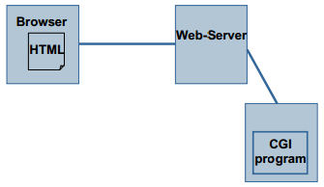
Categories of Web Applications: Interactive
content of a website is dynamically generated as response to a user request
form-based input is the primary mechanism for communication between client and server
usage of HTML-forms and Common Gateway Interface (CGI) techniques
radio button, string input, choice lists
examples:
dynamic HTML pages
public transport schedules
search engines

Slide 14
Categories of Web Applications: transaction-oriented
complex interactions
read and write actions
usage of transaction management of database systems
efficient and consistent data management
structured data and queries
examples:
online banking
e-shopping
reservation systems

Slide 15
Categories of Web Applications: workflow-based
support business processes („workflows“) within resp. between different enterprises or private users
an application provides a complex service to the user, e.g. assists the user in determining the mortgage payment
prerequisite: structured flow of activities
examples:
Business-to-Business (B2B) Integration Frameworks
E-Government
patient workflows in health care systems

Slide 16
Categories of Web Applications

Slide 17
Categories of Web Applications: Collaborative
support cooperation in case of unstructured flow of activities and high degree of communication
„groupware“
examples:
support of shared information- and workspaces
Wiki, http://c2.com/cgi/wiki
BSCW, http://bscw.gmd.de
chat rooms
e-Learning platforms

Slide 18
Categories of Web Applications: portal-oriented
the application channels the user to other Web content or services outside the domain of the portal application
„single point of access“
examples:
Community portals
dedicated user groups
customer profiles
enterprise portals
Intranet, extranet

Slide 19
Categories of Web Applications: ubiquitous
personalized services at every time at every location
multi-platform delivery (PC, PDA, mobile phone)
context-dependent information
examples:
display of today‘s menu on end-user devices while entering a restaurant

Slide 20
Categories of Web Applications: semantic web
information available on the web
adequate for human understanding and
adequate for automatic manipulation
„knowledge management“
derivation of new knowledge
re-use of knowledge
based on ontology's
examples:
Web 2.0
social software: wiki, Flickr, del.icio.us
Google

Slide 21
Categories of Web Applications

Slide 22
Characteristics of Web Applications

Slide 23
Characteristics of Web Applications

Slide 24
Characteristics of Web Applications: Content
Product
Presentation
Hypertext
Content
“content is king” in web applications
document-centered and multi-media
text, tables, graphics, animation, audio, video
main objective of web applications is to communicate content
high usability demands
high quality demands
actuality, preciseness, correctness, reliability, size
e-shopping: information about price, availability of products
quality is critical factor for acceptance of web applications

Slide 25
Characteristics of Web Applications: Hypertext
Product
Presentation
Hypertext
Content
non-linearity
main distinction to traditional software systems
systematic reading (“browsing, query, guided tour”)
navigation in information space depends on interest and previous knowledge of user
great challenge for web application authors
risks
disorientation: loss of sense of locality and direction
cognitive overload for users

Slide 26
Characteristics of Web Applications: Presentation
Product
Presentation
Hypertext
Content
aesthetics
look and feel
depending on current fashion
self-explanatory
intuitive use without reading any documentation
uniform application logics

Slide 27
Characteristics of Web Applications

Slide 28
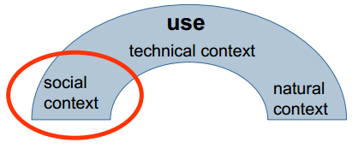
Characteristics of Web Applications:
spontaneity
users come and go ..
unknown number of users
scalability important issue
multiculturality
anonymous type of user
limited knowledge about previous knowledge, handicaps, preferences of users
desired adaptation of content and presentation

Slide 29
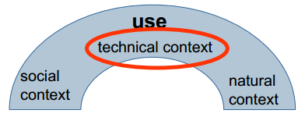
Characteristics of Web Applications:
quality of service
unknown network characteristics (e.g., bandwidth, reliability)
multi platform delivery
different types of devices (PC, tablet, mobile phone)
different versions of browsers
different degree of functionality, performance, display size, …

Slide 30
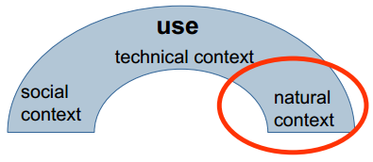
Characteristics of Web Applications:
place and time of access
globality
internationalization of web applications
regional, cultural, linguistic differences have to be taken into account
demands on security
prevent access to private or confidential data
availability
instant delivery mechanism (also in case of partial realizations)
permanent (24/7)
time-dependent services

Slide 31
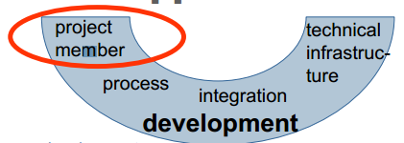
Characteristics of Web Applications:
multi disciplinary
mixture of
print publishing and software development
marketing and computer science
art and technology
IT-experts, hypertext experts, UI designer, domain experts, …
young average age of developers
“technology freak”, “nerd”
community development
open source
open content

Slide 32
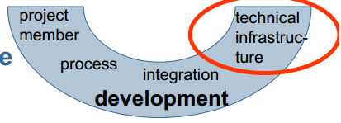
Characteristics of Web Applications:
inhomogeneity
two essential components
Web server (under control of developer)
Web browser (out of control of developer)
immaturity
“buggy” components due to time-to-market pressure
continuous evolution of base technology

Slide 33
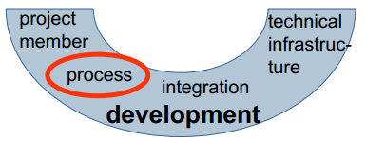
Characteristics of Web Applications:
flexibility
changing requirements
changing context
requires agile, light-weight processes
parallelism
of development of parts of web applications
of development steps

Slide 34
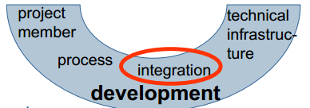
Characteristics of Web Applications:
internal integration
add web access to legacy systems
external integration
of content and services of external web applications (“web services”)
similarity to integration of heterogeneous database systems, but
high autonomy of sources w.r.t. to availability and change
few detailed information about sources
heterogeneity on different levels (data, schema, data model)

Slide 35
Characteristics of Web Applications

Slide 36
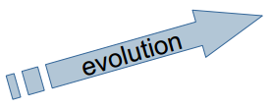
Characteristics of Web Applications:
continuous change
permanent evolution
changing requirements and contexts
change of characteristics product, use, or development
competitive pressure
time-to-market
necessity of web presence
leads to shorter product life cycles
leads to shorter development cycles
fast pace
“either you are fast or irrelevant”

Slide 37
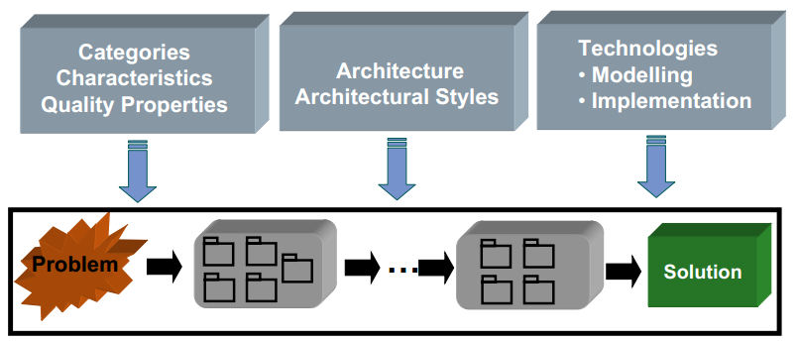
Support for Web Application Development
Model-based Development

Slide 38
Support for Web Application Development
Model-based Development

Slide 39
Quality of Web Applications
Kinds of quality properties
External qualities are visible to the user
Internal qualities are visible to / concerning the developer
Model-based Development

Slide 40
Quality of Web Applications external qualities
correctness:
a web application is functionally correct if it behaves according to the specification of the application
reliability:
the probability that the software will operate as expected
occurring software errors are not serious
robustness:
software behaves reasonably even in circumstances that were not anticipated in the requirements specification

Slide 41
Quality of Web Applications external qualities
actuality:
actuality of content must be guaranteed
user-friendliness:
easy to use by human (novice / experts)
efficiency:
economical handling of resources (time, storage space)
security:
system is protected from unauthorized access

Slide 42
Quality of Web Applications internal qualities
portability:
a web application is portable if it can run in different environments
interoperability:
refers to the ability of the web application to coexist and cooperate with other systems
maintainability:
ability to modify a web application after it has been deployed
correct errors
extend the web application

Slide 43
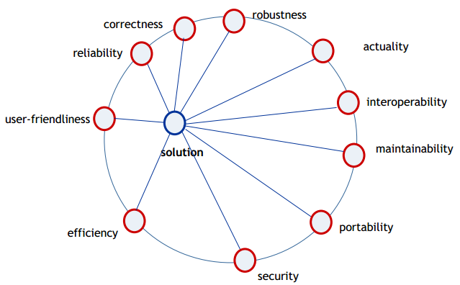
Quality of Web Applications Compromise
Choose/design your own solution

Slide 44
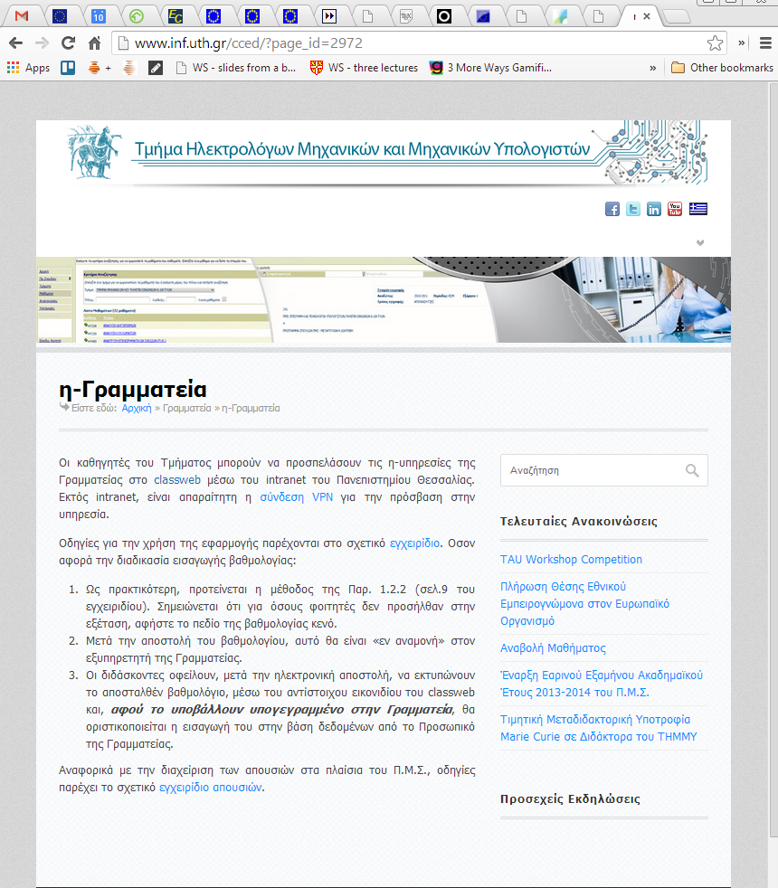
Navigation in Web Applications
Broken or wrong links

Slide 45
Development of Web Applications: today’s approach
ad-hoc development
based on knowledge, experiences and practices of individual developers
reuse of existing applications by “copy&paste” approach
insufficient documentation of design decisions
isolated activity: no “design for change”
missing methodical approach

Slide 46
Reasons for Quality Deficiencies
document-centered view
development of web applications seen as editorial activity: “ (textual) web pages, links and use of graphics”
misconception that web applications are simple
due to availability of tools like HTML-editors and form generators
no use of know-how of relevant disciplines
no use of software engineering know-how
no use of hypermedia or HCI (Human Computer Interaction) know-how

Slide 47
Web Crisis
• comparable to software crisis at the end of the 60’ies
• lead to origin of “software engineering” discipline
• “web engineering” is needed!

Slide 48
Difference to software systems?
What are the differences of general software systems and web applications?
Can we use the same techniques to develop web applications as we are using for developing software systems in general?
Web Engineering =? Software Engineering

Slide 49
Difference to software systems?
What are the differences of general software systems and web applications?
Can we use the same techniques to develop web applications as we are using for developing software systems in general?

Slide 50
Web Engineering (WE) applies sound scientific, engineering, and management principles and disciplined and systematic approaches to the successful development, deployment, and maintenance of high-quality Web-based systems and applications.

Slide 51
Web Applications & Web Services

